Slide 1



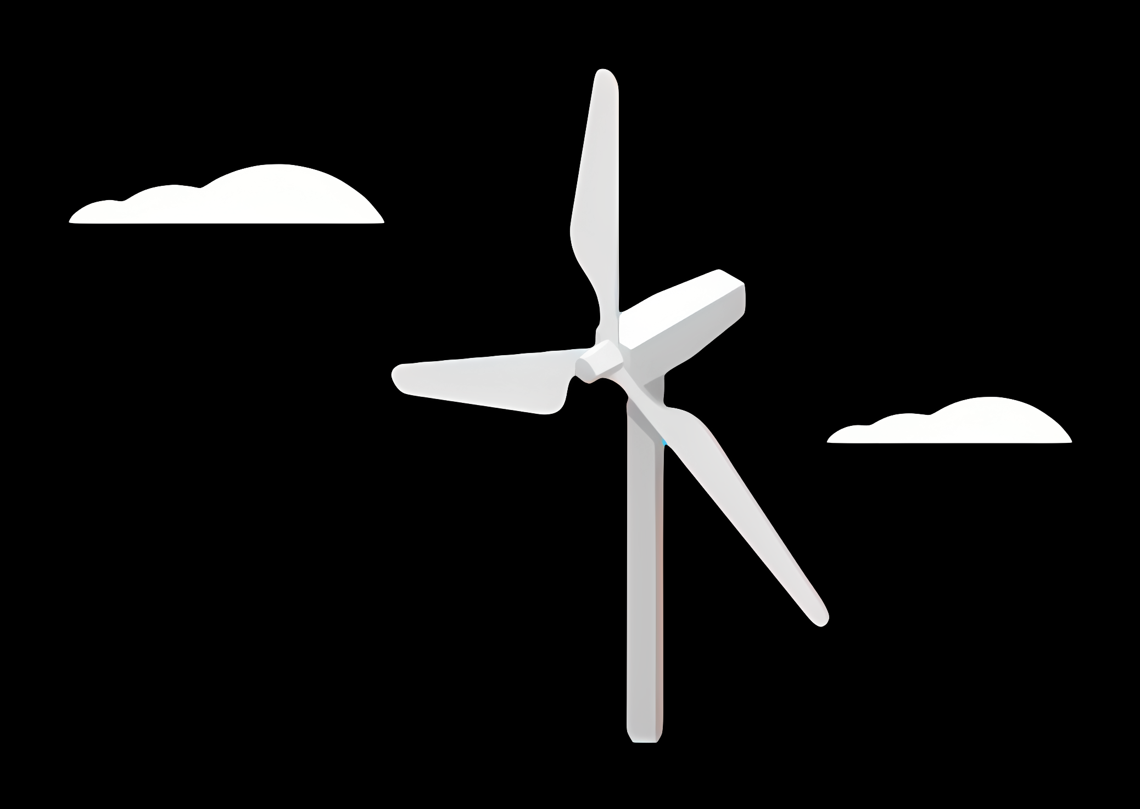
Report: Lidar Assisted Controller
Kick off Meeting (Optimus Syria)
Date: 23/08/2025
Supervisor: Prof. Dr. -Ing. David Schlipf
Group members: Annika Gäthje, Hesham Mahmoud, Md Aman, Midhun Kanichattu Venu

Slide 2
Content
Technical Insights
Consideration
Team Progress
Future Plans
Conclusions
Bibliography

Slide 3
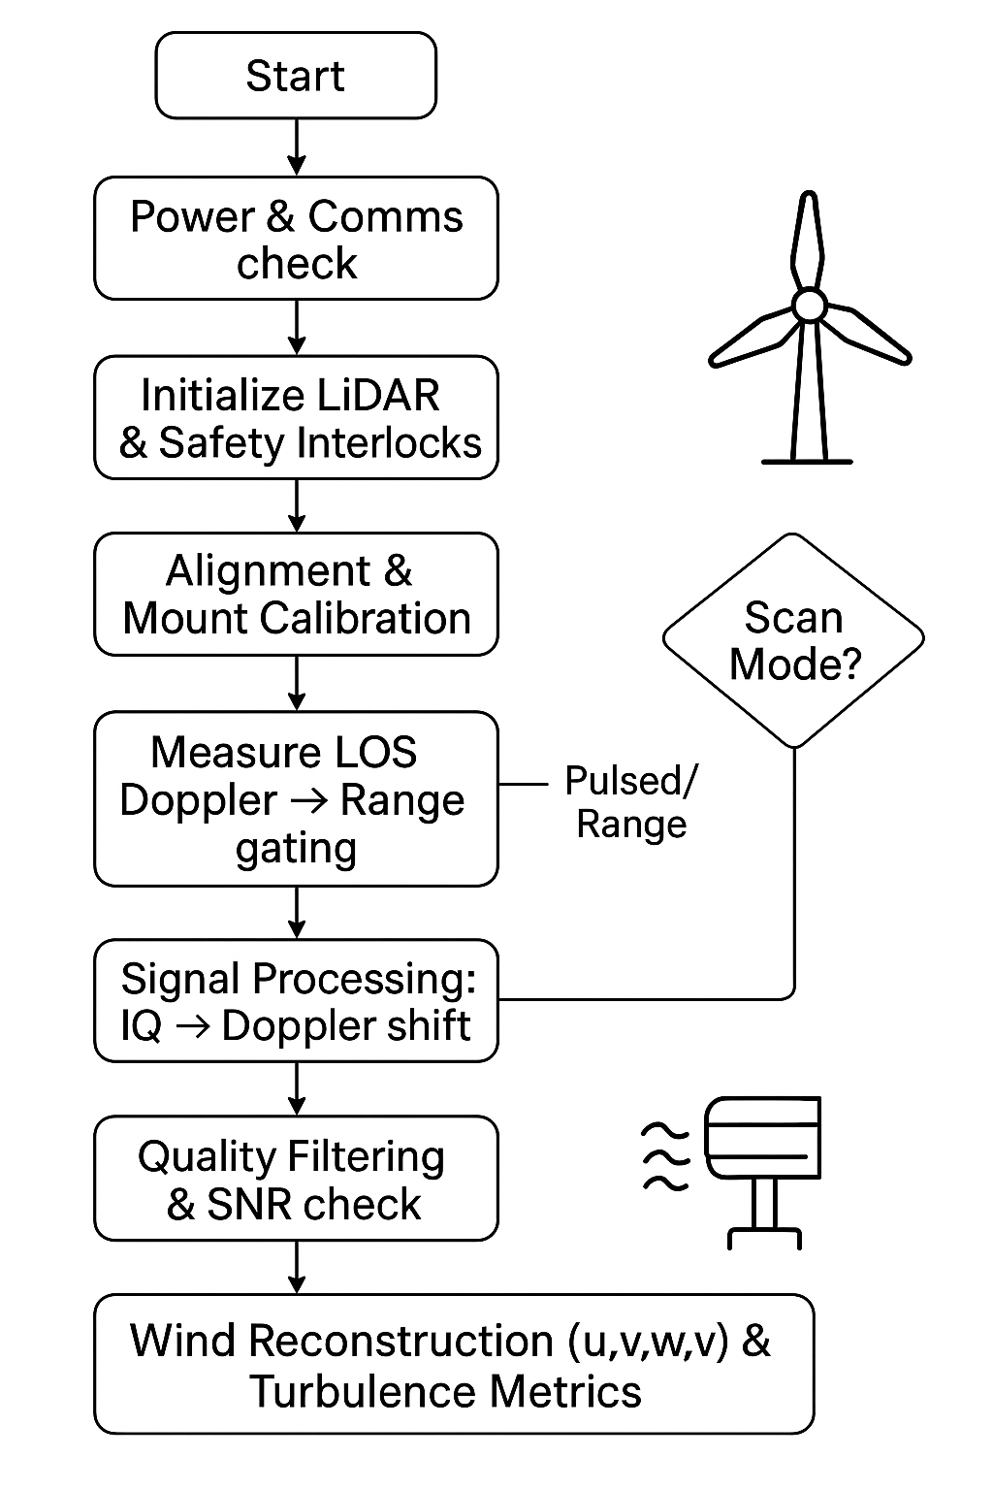
Technical Insights
Lidar-Assisted Control (LAC) can reduce turbine loads, improve pitch control response, and modestly increase energy capture or lifetime — especially using collective-pitch feedforward control.
Start with nacelle-mounted LiDAR + collective-pitch feedforward (most proven LAC method) to reduce turbine loads and extend lifetime.
Ensure dust/visibility mitigation and robust fallback control so turbines safely revert to baseline if LiDAR signals degrade.

Slide 4
Considerations
Dust conditions require LiDAR protection and reliable fallback control.
Grid instability needs smoother power output from LAC.
Account for access, site security, and spare parts supply chains. Consider remote diagnostics to reduce on-site visits.
Train local O&M teams on LiDAR calibration and control fallback procedures during project rollout.

Slide 5
Team Progress(Individual Progess)
Annika Gäthje
Matlab Intermediate Done
Python Basic Started
Fortran Basic Started
LiDAR Basic Started
Literature Files All Completed
Hesham Mahmoud
Matlab Basic Started
Python Basic Started
Fortran Basic Started
LiDAR Basic Started
Literature Files 1st File Completed
Md Aman
Matlab Intermediate Started
Python Basic Started
Fortran Basic Started
LiDAR Intermediated Started
Literature Files 1st File Completed
Midhun Kanichattu Venu
Matlab Intermediate Started
Python Intermediate Started
Fortran Basic Started
LiDAR Intermediated Started
Literature Files Completed

Slide 6
Team Progress(Weekly wise)
Week 1
Week 2
Setup meeting get familiar with each other. Make a road plan for team progress. Downloaded software and installed them.
Started learning with software’s basics like Matlab and Python. Started studying files given by professor. Meet with feedback control group.
Week 3
Week 4
Finished Basics of Matlab and Python. Installed Fortran Software and planned meeting with professor for further guidance.
Meet with professor. Started learning of basics of Fortran software. Also started intermediate of Matlab software which guided to us by professor. Started Simulation with Matlab.

Slide 7
Future Plans
Start Fortran implementation.
Enhance MATLAB/Python through applied tasks.
Finish literature reviews and identify research focus.
Analyze previous project data for control insights.
Develop and test LiDAR-based control strategies.

Slide 8
Conclusion
1. Gained basic to intermediate skills in MATLAB, Python, Fortran.
2. Developed Syrian conditions and simulate working with LiDAR.
3. Complete key tutorials and started reviewing the literature.
4. Reviewed past project files and related data.
5. Team is well-prepared for the next development phase.

Slide 9
Bibliography
Schlipf, D., Simley, E., Lemmer, F., Pao, L., & Cheng, P. W. (2015). Collective pitch feedforward control of floating wind turbines using lidar. Journal of Ocean and Wind Energy, 2, 223–230
Canet, H., Loew, S., & Bottasso, C. L. (2021). What are the benefits of lidar-assisted control in the design of a wind turbine? Wind Energy Science, 6(5), 1325–1340

